Slide 1
Playful Interaction Session #03
Course : GAME6012/ User Experiences
Effective Period : September 2017

Slide 2
Learning Objectives

Slide 3
Playful interaction?
in the context of dating, we use playful behaviors to connect with others. we tease each other with little tidbits of information about ourselves. we serve up flirtatious smiles at just the right moment. we ask silly questions or make humorous propositions. we “accidentally” brush a hand against the other person’s skin. Assuming there’s some mutual interest, these signals say, “Hang out with me and you’ll have a good time.”

Slide 4
Is it fun?
Compare the differences

Slide 5
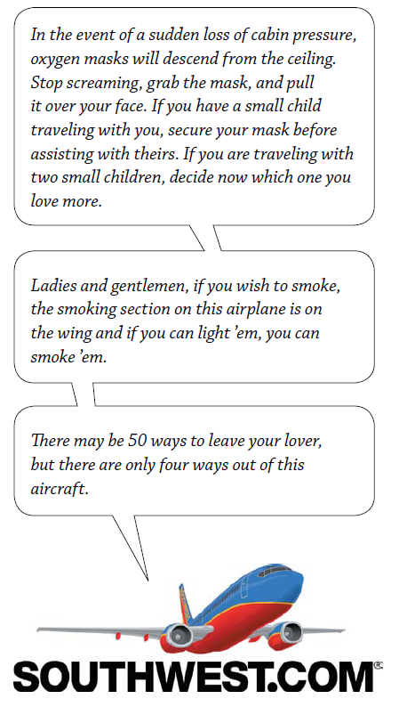
More fun!

Slide 6
Unpredictably Fun
A downloading screen where you play game

Slide 7
Stimulating your audience
Look at the image, see the anything interesting?
if you stare long enough, no doubt you’ll find several patterns. But there isn’t one, at least not intentionally. The brain naturally seeks ways to organize and simplify complex information, even when there is no pattern. and when we find a pattern, we are delighted. it’s akin to solving the Rubik’s Cube, or aligning jewels in Bejeweled. We delight in bringing order to chaos. in fact, our brains actually get a brief “high” from solving difficult problems.

Slide 8
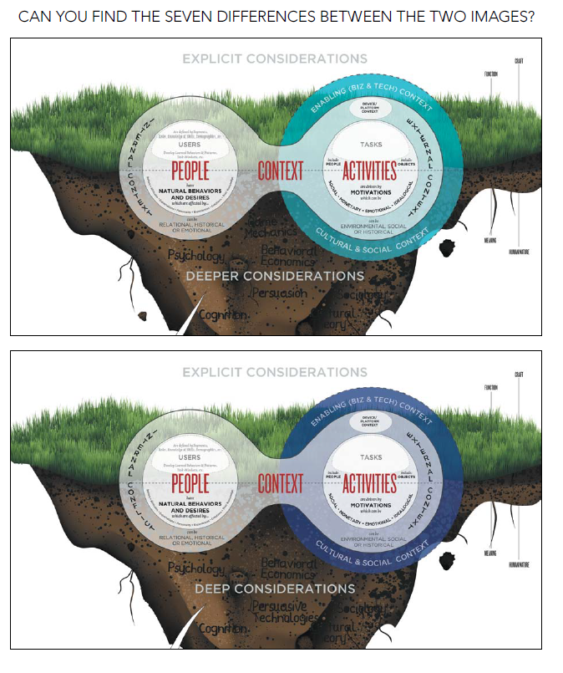
Stimulating you audience

Slide 9
Being Mysterious?
Mysterious car from hot wheels?

Slide 10
Hurdle or interesting mystery?

Slide 11
Example

Slide 12
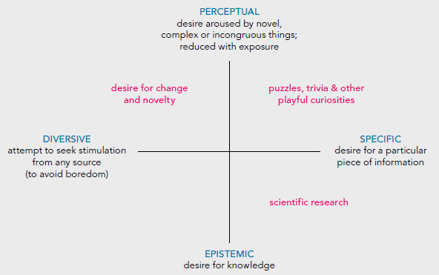
Curiosity Matrix

Slide 13
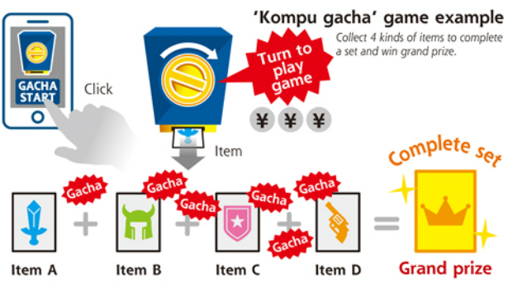
Case study
Does gacha is in the field of Mystery?

Slide 14
Assignment
Search for a game and playstore, improve the game by adding
Mysterious element
Audience Stimulation
More playful interaction

Slide 15
References
Buxton, William. 2007. Sketching user experience. Elsevier
Anderson, Stephen. 2011. Seductive Interaction Design. New Riders.
Faranello, Scott. 2016. Practical UX Design. Packt Publishing

